Slide 1
COMMUNICATION SYSTEMS
By
Prof. Prajeesha
E&CE Dept

Slide 2
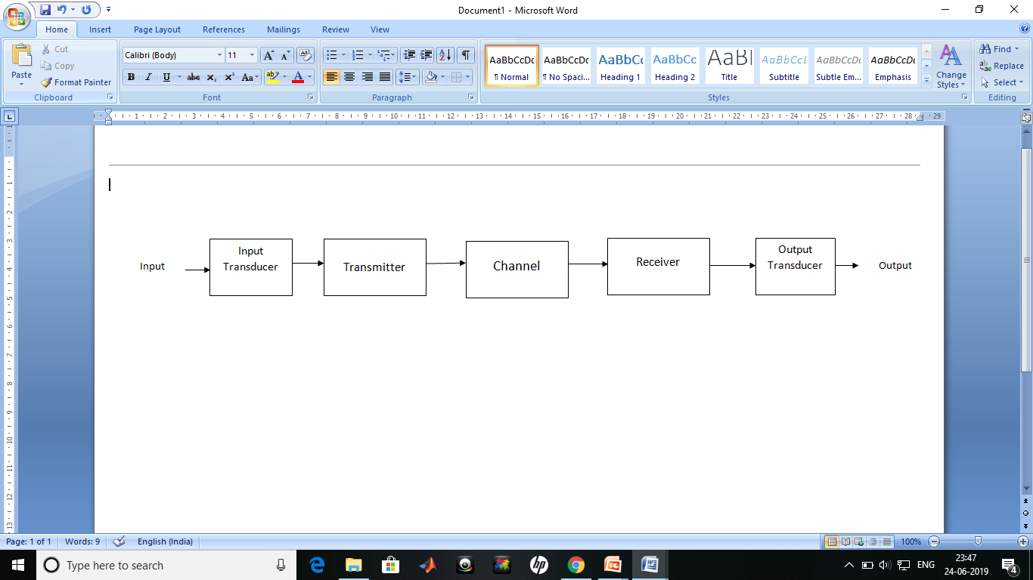
Electronic Communication systems
A communication system is composed of following blocks

Slide 3
Input Transducer
Source: Analog or digital
Example: Speech, music, written text
Input Transducer: Converts the message produced by a source to a form suitable for the communication system.
Example:
Speech waves → Microphone→ Voltage

Slide 4
transmitter
The transmitter converts the input signal to transmitted signal suited for the transmission channel.
Basic operations in the transmitter
• Modulation
• Coding

Slide 5
Channel
Physical medium that does the transmission
Examples: Air, wires, coaxial cable, radio wave, laser beam, fiber optic cable
Every channel introduces some amount of distortion, noise and interference

Slide 6
Effects of the channel on the transmitted signal
• Attenuation: decreasing the signal strength;
• Distortion of the signal waveform: caused by channel characteristics (linearity, frequency response, etc.)
• Noise: contamination of random natural signals added to the transmitted signal
• Interference: contaminations of extraneous signal of human sources – machinery, power lines, digital switching circuits, etc.

Slide 7
Receiver
Extracts message from the received signal
Operations:
Amplification
Demodulation
Filtering
Decoding
Goal: The receiver output is a scaled, possibly delayed version of the message signal (ideal transmission)
Examples: TV set, radio, web client

Slide 8
Output Transducer
Converts electrical signal into the form desired by the system
Examples: Loudspeakers, PC

Slide 9
One-way or simplex (SX) transmission - Transmission in one direction only.
Full-duplex (FDX) system – a system, which channel allows transmission in both directions.
Full-duplex (HDX) system – a system, which channel allows transmission in both directions but not simultaneously.

Slide 10
Modulation
Modulation is a process of changing the carrier signal characteristics according to the message Signal.
Types of Modulation:
Continuous Modulation : AM,FM
Digital Modulation: ASK,PSK,FSK

Slide 11
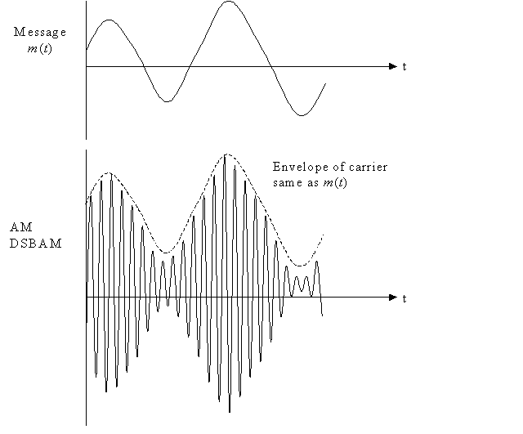
Amplitude Modulation
If the amplitude of the carrier is varied according to the message it is called as Amplitude modulation

Slide 12
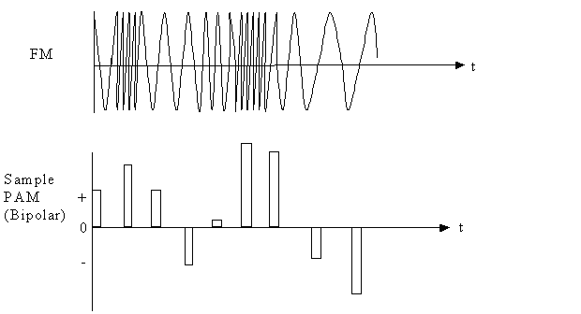
Frequency Modulation
If the frequency of the carrier is varied according to message it is called as Frequency modulation

Slide 13
Need for Modulation
Modulation increases the distance over which the signal can be transmitted faithfully
Modulation for efficient transmission; Modulation to overcome hardware limitation;
Modulation reduces the height of the antenna.
Modulation avoid Mixing of signals
Modulation will reduce noise and interference.
Modulation for multiplexing
Modulation helps to adjust bandwidth.

Slide 14
Demodulation
The process of recovering the message from the modulated signal is called demodulation.
Two types of demodulation
Coherent : systems need carrier phase information at the receiver to detect and decide what data was sent
Non coherent : systems do not need carrier phase information

Slide 15
Fundamental Limitations in Communications
Limitations Due to Technological Problems
• Hardware availability
• Economic factors
• International and national regulating norms

Slide 16
Fundamental Physical Limitations
Transmission Bandwidth B.
• Limits the spectrum of the transmitted signal, i.e. the maximum speed of variation of the transmitted signal.
• The time required for transmission of a given amount of information is inversely proportional to the transmission bandwidth B.

Slide 17
Noise
• Noise is generated in all conductors and in electronic devices as well.
• Thermal noise due to random motion of the charged particles like electrons.
• Noises generated in electronic devices: shot, flicker, popcorn, avalanche.
The noise degrades the fidelity in analog communication systems and produces errors in digital communications.
Noise generation limits the weakest transmitted signal.
Significant in long-distance communications when the signal attenuation is large.

Slide 18
Signal-to-noise ratio
S/N = signal power / noise power
Hartley-Shannon low
The rate of information transmission cannot exceed the channel capacity
C = Blog(1+S/N)

Slide 19
The Cellular Concept
System Design Fundamentals

Slide 20
Introduction
Goals of a Cellular System
High capacity
Large coverage area
Efficient use of limited spectrum
Large coverage area - Bell system in New York City had early mobile radio
Single Tx, high power, and tall tower
Low cost
Large coverage area - Bell system in New York City had 12 simultaneous channels for 1000 square miles
Small # users
Poor spectrum utilization

Slide 21
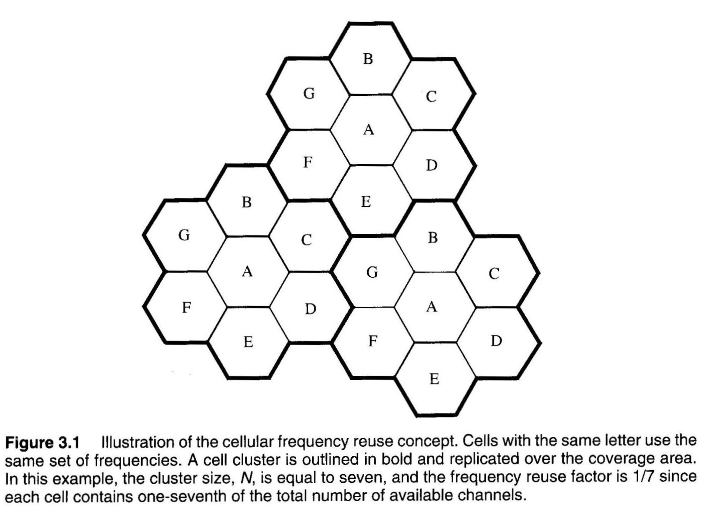
Cellular concept
Frequency reuse pattern

Slide 22
Cells
Base station antennas designed to cover specific cell area
Hexagonal cell shape assumed for planning
simple model for easy analysis → circles leave gaps
actual cell “footprint” is amorphous (no specific shape)
where Tx successfully serves mobile unit
Base station location
cell center → omni-directional antenna (360° coverage)
not necessarily in the exact center (can be up to R/4 from the ideal location)

Slide 23
cell corners → sectored or directional antennas on 3 corners with 120° coverage.
very common
Note that what is defined as a “corner” is somewhat flexible → a sectored antenna covers 120° of a hexagonal cell.
So one can define a cell as having three antennas in the center or antennas at 3 corners.

Slide 24
Cellular concept continued…
Cells labelled with the same letter use the same group of channels.
Cell Cluster: group of N cells using complete set of available channels
Many base stations, lower power, and shorter towers
Small coverage areas called “cells”
Each cell allocated a % of the total number of available channels
Nearby (adjacent) cells assigned different channel groups
to prevent interference between neighbouring base stations and mobile users

Slide 25
Same frequency channels may be reused by cells a “reasonable” distance away
reused many times as long as interference between same channel (co-channel) cells is < acceptable level
As frequency reuse↑ → # possible simultaneous users↑→ # subscribers ↑→ but system cost ↑ (more towers)
To increase number of users without increasing radio frequency allocation, reduce cell sizes (more base stations) ↑→ # possible simultaneous users ↑
The cellular concept allows all mobiles to be manufactured to use the same set of freqencies
*** A fixed # of channels serves a large # of users by reusing channels in a coverage area ***

Slide 26
Handoff Strategies
Handoff: when a mobile unit moves from one cell to another while a call is in progress, the MSC must transfer (handoff) the call to a new channel belonging to a new base station
new voice and control channel frequencies
very important task → often given higher priority than new call
It is worse to drop an in-progress call than to deny a new one

Slide 27
choose a (handoff threshold) > (minimum useable signal level)
so there is time to switch channels before level becomes too low
as mobile moves away from base station and toward another base station

Slide 28
Typical handoff parameters
Analog cellular (1st generation)
threshold margin △ ≈ 6 to 12 dB
total time to complete handoff ≈ 8 to 10 sec
Digital cellular (2nd generation)
total time to complete handoff ≈ 1 to 2 sec
lower necessary threshold margin △ ≈ 0 to 6 dB
enabled by mobile assisted handoff

Slide 29
benefits of small handoff time
greater flexibility in handling high/low speed users
queuing handoffs & prioritizing
more time to “rescue” calls needing urgent handoff
fewer dropped calls → GOS increased
can make decisions based on a wide range of metrics other than signal strength
such as also measure interference levels
can have a multidimensional algorithm for making decisions

Slide 30
MSC dynamically decides which signal is best and then listens to that one
Soft Handoff
passes data from that base station on to the PSTN
This choice of best signal can keep changing.
Mobile user does nothing for handoffs except just transmit, MSC does all the work
Advantage unique to CDMA systems
As long as there are enough codes available

Slide 31
Co-Channel Interference
Interference is the limiting factor in performance of all cellular radio systems
What are the sources of interference for a mobile receiver?
Interference is in both
voice channels
control channels

Slide 32
Frequency Reuse
Many cells in a given coverage area use the same set of channel frequencies to increase system capacity (C)
Co-channel cells → cells that share the same set of frequencies
VC & CC traffic in co-channel cells is an interfering source to mobiles in Several different cells

Slide 33
Possible Solutions?
1) Increase base station Tx power to improve radio signal reception? _
this will also increase interference from co-channel cells by the same amount
no net improvement
2) Separate co-channel cells by some minimum distance to provide sufficient isolation from propagation of radio signals?
If all cell sizes, transmit powers, and coverage patterns ≈ same → co-channel interference is independent of Tx power

